Slide 1
بِسْمِ اللهِ الرَّحْمٰنِ الرَّحِيْمِ

Slide 2

Natural Language Processing (NLP)
Lecture 02 –
Text Pre-processing
Instructor:
Dr. Jawad Shafi

Slide 3
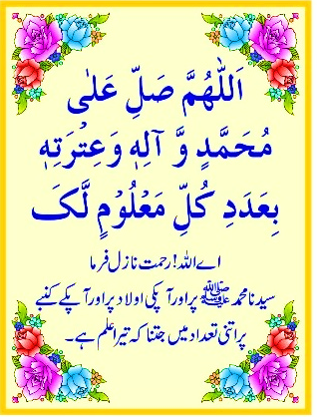
Dua – Take Help from Allah Before Starting Any Task
اللَّهُمَّ خِرْ لِيْ وَاخْتَرْ لِي
سُبْحَانَكَ لَا عِلْمَ لَنَا إِلَّا مَا عَلَّمْتَنَا ۖ
إِنَّكَ أَنْتَ الْعَلِيمُ الْحَكِيمُ
رَبِّ اشْرَحْ لِي صَدْرِي
وَيَسِّرْ لِي اَمْرِي
وَاحْلُلْ عُقْدَةً مِنْ لِسَانِي
يَفْقَهُوا قَوْلِي

Slide 4
Lecture Outline – Key Topics
NLP Research Community
NLP Conferences
NLP Tasks

Slide 5
NLP Research Community

Slide 6
The NLP Research Community
Papers
ACL Anthology has nearly everything, free!
About 90,000 papers!
Free-text searchable
Great way to learn about current research on a topic
New search interfaces currently available in beta
Find recent or highly cited work; follow citations
Used as a dataset by various projects
Analyzing the text of the papers (e.g., parsing it)
Extracting a graph of papers, authors, and institutions (Who wrote what? Who works where? What cites what?)
Google Scholar to sort by citation count / track citations

Slide 7
The NLP Research Community
Conferences
Most work in NLP is published as 9-page conference papers with 3 double-blind reviewers.
Papers are presented via talks, posters, videos
Also:
Conference short papers (5 pages)
“Findings” papers (accepted but without presentation)
“System demo track” / “Industry track”
Journal papers (up to 12 pages, or unlimited)
Main annual conferences: ACL, EMNLP, NAACL
+ EACL, AACL/IJCNLP, COLING, …; also LREC
+ journals: TACL, CL, JNLE, …
+ AI/ML journals: JAIR, JMLR, …
+ various specialized conferences and workshops

Slide 8
The NLP Research Community
Conferences
Pre-COVID, ACL had > 2000 in-person attendees
Kind of a zoo! It used to be 200 people and few enough talks that you could go to all of them …
ACL 2023:
4864 papers submitted (1074 accepted)
Accepted:
910 “long” (9 pages) – 23.5% acceptance rate
164 “short” (5 pages) – 16.5% acceptance rate
+ 901 “findings” published outside main conf (including these gives 41% overall acceptance rate)
Awards: Several papers (will be widely read)

Slide 9
“Tracks” (at ACL 2021)
used to organize reviewing and presentation for most papers
Information Extraction
Information Retrieval & Text Mining
Question Answering
Summarization
Machine Translation & Multilinguality
Speech & Multimodality
Discourse & Pragmatics
Sentiment Analysis, Stylistic Analysis, & Argument Mining
Dialogue & Interactive Systems
Language Grounding to Vision, Robotics & Beyond
Computational Social Science & Cultural Analytics
NLP Applications
Special theme: NLP for Social Good
Machine Learning for NLP
Interpretability & Analysis of Models for NLP
Resources & Evaluation
Ethics & NLP
Phonology, Morphology & Word Segmentation
Syntax: Tagging, Chunking & Parsing
Semantics: Lexical
Semantics: Sentence-level Semantics, Textual Inference & Other areas
Linguistic Theories, Cognitive Modeling & Psycholinguistics
+ 23 workshops on various topics

Slide 10
The NLP Research Community
Chitchat
arXiv papers
Twitter accounts
NLP researchers with active accounts (grad students, profs, industry folks)
Official conference accounts
“NLP Highlights” podcast
“NLP News” newsletter

Slide 11
The NLP Research Community
Institutions
Universities: Many have 2+ NLP faculty
Several “big players” with many faculty
Some of them also have good linguistics, cognitive science, machine learning, AI
Companies:
Old days: AT&T Bell Labs, IBM
Now: Microsoft Research, Google Brain/DeepMind, FAIR, Amazon, startups …
Nonprofits: AI2, HuggingFace, TTIC, …
Many niche markets – online reviews, medical transcription, news summarization, legal search and discovery …

Slide 12
The NLP Research Community
Standard tasks
If you want people to work on your problem, make it easy for them to get started and to measure their progress. Provide:
Test data, for evaluating the final systems
Development data (= validation data) for measuring whether a change to the system helps, and for tuning parameters
An evaluation metric (formula for measuring how well a system does on the dev and test data)
“If you can’t measure it, you can’t improve it” – Peter Drucker
A program for computing the evaluation metric
Labeled training data and other data resources
A prize? – with clear rules on what data can be used
NLP-progress repo tracks the “state of the art” (SoTA)
Workshops sometimes create new “shared tasks”

Slide 13
The NLP Research Community
Software
Lots of people distribute code for these tasks
Search github – fun to download packages and play around!
Or you can email a paper’s authors to ask for their code
Some lists of software, but no central site ☹
PapersWithCode.com
Search for “awesome NLP” for some lists
Toolkits and end-to-end pipelines for text analysis
Hugging Face – > 20,000 models, > 2,000 datasets
Large pretrained models: pip install transformers (quick tour)
Task-specific models: pip install allennlp, etc.
Allen NLP (Python), Spacy (Cython), UDPipe (C++), Stanza (Python), CoreNLP (Java), NLTK (Python)

Slide 14
The NLP Research Community
Software
To find good or popular tools:
Identify current papers, ask around, search the web
Trying to identify the best tool for your job:
Produces appropriate, sufficiently detailed output?
Accurate? (on the measure you care about)
Robust? (accurate on your data, not just theirs)
Fast?
Easy and flexible to use? Nice file formats, command line options, visualization?
Trainable for new data and languages? How slow is training?
Open-source and easy to extend?

Slide 15
The NLP Research Community
Datasets
Raw text or speech corpora
Or just their n-gram counts, for super-big corpora
Various languages and genres
Usually there’s some metadata (each document’s date, author, etc.)
Sometimes ∃ licensing restrictions (proprietary or copyright data)
Text or speech with manual or automatic annotations
What kind of annotations? That’s the rest of this lecture …
May include translations into other languages
Words and their relationships
phonological, morphological, semantic, translational, evolutionary
Grammars
World Atlas of Linguistic Structures
Parameters of statistical models (e.g., grammar weights)

Slide 16
The NLP Research Community
Datasets
Read papers to find out what datasets others are using
Linguistic Data Consortium (searchable) hosts many large datasets
Many projects and competitions post data on their websites
But sometimes you have to email the author for a copy
CORPORA mailing list is also good place to ask around
LREC Conference publishes papers about new datasets & metrics
Pay humans to annotate your data
Or to correct the annotations produced by your initial system
Old task, new domain: Annotate parses etc. on your kind of data
New task: Annotate something new that you want your system to find
Auxiliary task: Annotate something new that your system may benefit from finding (e.g., annotate subjunctive mood to improve translation)
Can you make annotation so much fun or so worthwhile that they’ll do it for free?

Slide 17

Crowdsourcing
E.g., Mechanical Turk
Pay humans small amounts of money to do “Human Intelligence Tasks” (HITs)
If you post it, they will come …
… although they’ll go away again if other people’s tasks are more pleasant / better paid

Slide 18
The NLP Research Community
Standard data formats
Often just simple ad hoc text-file formats
Documented in a README; easily read with scripts
Some standards:
Unicode – strings in any language (see ICU toolkit)
PCM (.wav, .aiff) – uncompressed audio
BWF and AUP extend w/metadata; also many compressed formats
XML – documents with embedded annotations
Text Encoding Initiative – faithful digital representations of printed text
Protocol Buffers, JSON – structured data
UIMA – “unstructured information management”; Watson uses it
Standoff markup: raw text in one file, annotations in other files (“∃ noun phrase from byte 378—392”)
Annotations can be independently contributed & distributed

Slide 19
The NLP Research Community
Survey articles
May help you get oriented in a new area
Synthesis Lectures on Human Language Technologies
Oxford Handbook of Computational Linguistics (2014)
Foundations & Trends in Machine Learning
Survey articles in journals – JAIR, CL, JMLR
ACM Computing Surveys?
Search online for tutorial papers and survey papers
Slides from tutorials at conferences
Textbooks
Dissertation literature review chapters
Notes:
deleted: Handbook of Natural Language Processing

Slide 20
To Write A Typical Paper
*Evaluation is harder for unsupervised learning or text generation. There’s not a single right answer …
Need some of these ingredients:
A domain of inquiry
A task
Resources
A method for training & testing
An algorithm
Analysis of results
There are other kinds of papers too: theoretical papers on formal grammars and their properties, new error metrics, new tasks or resources, etc.
Scientific or engineering question
Input & output representations, evaluation metrics*
Corpora, annotations, dictionaries, …
Derived from a model?
Comparison to baselines & other systems, significance testing, learning curves, ablation analysis, error analysis

Slide 21

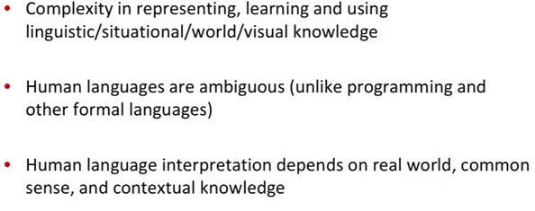
Why NLP is Hard?
Definition
Outcome

Slide 22
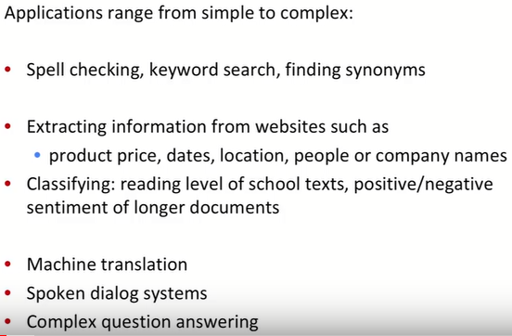
A tiny Sample of NLP Applications

Slide 23
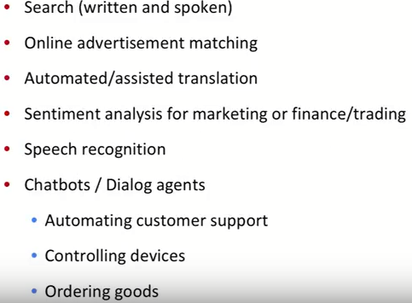
NLP in Industry

Slide 24

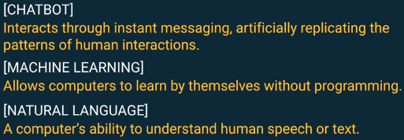


Chatbot →

Slide 25
Applications of NLP
Automatic summarization
Information extraction
Information retrieval
Machine translation
Named entity recognition
Natural language understanding
Natural language generation
Optical Character Recognition
Question answering
Speech Processing
Spoken dialogue system
Text simplification
Text to speech
https://www.youtube.com/watch?v=8S3qHHUKqYk

Slide 26
Automatic summarization
Subfield of machine learning and data mining
Process of shortening a text document with software, in order to create a summary with the major points of the original document.
Find a subset of data which contains the "information" of the entire set.
Possible for documents, image collections and videos.
Two general approaches: extraction and abstraction.
Notes:
Document summarization tries to create a representative summary or abstract of the entire document, by finding the most informative sentences,
Data mining is the process of sorting through large data sets to identify patterns and establish relationships to solve problems through data analysis. Data mining tools allow enterprises to predict future trends.
DM is the process of discovering patterns in large data sets involving methods at the intersection of machine learning, statistics, and database systems.

Slide 27
Automatic summarization: Types
Extractive methods work by selecting a subset of existing words, phrases, or sentences in the original text to form the summary.
Abstractive methods build an internal semantic representation and then use natural language generation techniques to create a summary that is closer to what a human might express. Such a summary might include verbal innovations.
Extractive methods are appropriate for image collection and video summarization.
Notes:
In image summarization the system finds the most representative and important (i.e. salient) images.
surveillance videos, one might want to extract the important events from the uneventful context.

Slide 28
Information extraction
the task of automatically extracting structured information from unstructured and/or semi-structured machine-readable documents.
Recent activities in multimedia document processing like automatic annotation and content extraction out of images/audio/video could be seen as information extraction.

Slide 29
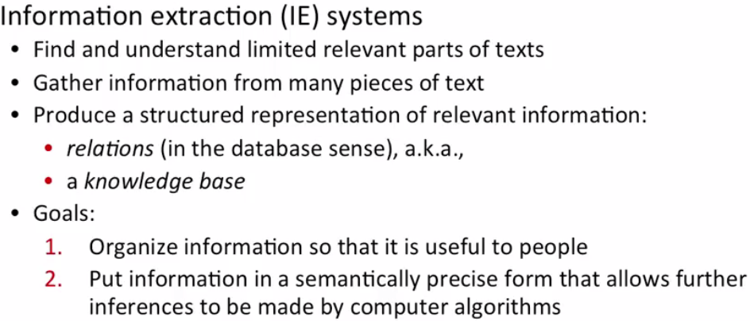
Information Extraction
Notes:
Aka : also known as

Slide 30
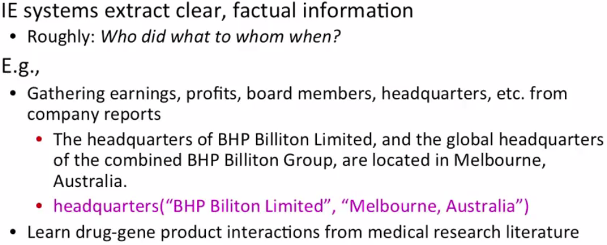
Information Extraction

Slide 31
Information retrieval (IR)
the activity of obtaining information resources relevant to an information need from a collection of information resources.
Information retrieval is the science of searching for information in a document, searching for documents themselves, and also searching for metadata that describe data, and for databases of texts, images or sounds.
Automated information retrieval systems are used to reduce what has been called information overload.
Web search engines are the most visible IR applications.
Other IR systems Solr, Lucene, Elastic Search.

Slide 32
Machine translation
sometimes referred to by the abbreviation MT is a sub-field of computational linguistics that investigates the use of software to translate text or speech from one language to another.

Slide 33
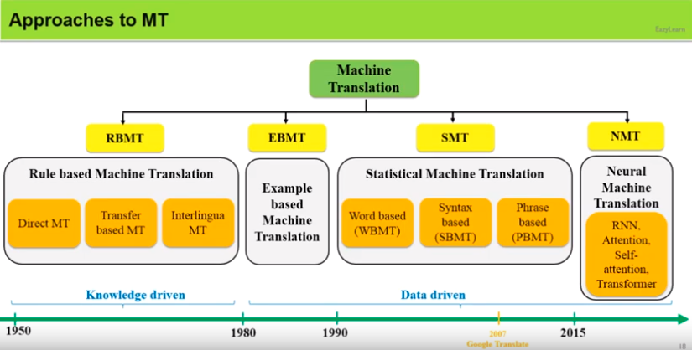
MT Approaches
https://www.youtube.com/watch?v=My_aXkRlkfA

Slide 34
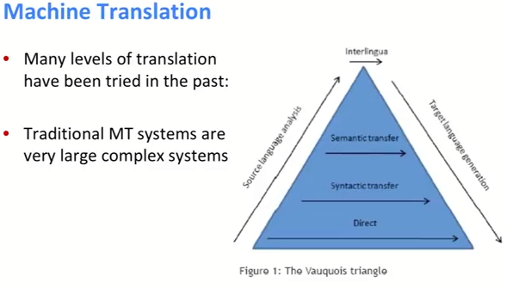

Slide 35
Named-entity recognition (NER)
also known as entity identification, entity chunking and entity extraction
subtask of information extraction that seeks to locate and classify named entities in text into pre-defined categories such as the names of persons, organizations, locations, expressions of times, quantities, monetary values, percentages, etc.
Most research on NER systems has been structured as taking an unannotated block of text, such as: Jim bought 300 shares of Acme Corp. in 2006.
And producing an annotated block of text that highlights the names of entities:
[Jim]_{Person} bought 300 shares of [Acme Corp.]_{Organization} in [2006]_{Time}.

Slide 36
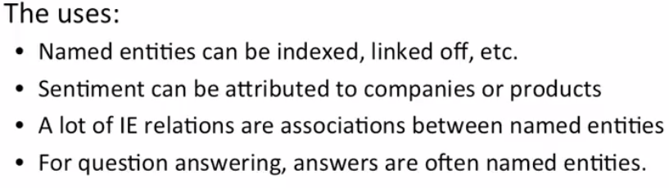
Named-entity recognition (NER)

Slide 37
Optical Character Recognition
A system that provides a full alphanumeric recognition of printed or handwritten characters at electronic speed by simply scanning the form.

Slide 38
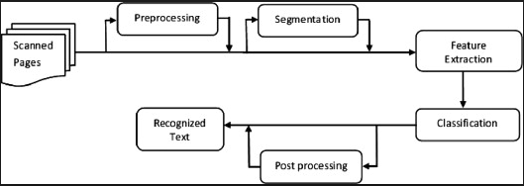
An OCR System

Slide 39
QUESTION AND ANSWERING
Type of information retrieval.
Given a collection of documents, the system should be able to retrieve answers to questions posed in natural language.
Find the answer to a question in a large collection of documents.
The main aim of QA is to present the user with a short answer to a question rather than a list of possibly relevant documents.
As it become more and more difficult to find answers on the WWW using standard search engines, question answering technology will become increasingly important.

Slide 40
Speech Recognition
is the process of converting an acoustic signal, captured by a microphone or a telephone, to a set of words.
The recognised words can be used as an input to next system, as for applications such as commands & control, data entry, and document preparation. They can also serve as the input to further linguistic processing in order to achieve speech understanding.

Slide 41
Spoken Dialogue System
is an automated system that engages in a dialogue with a human user using spoken language as the medium of interaction.
1)Task-oriented: involves the use of dialogues to accomplish a task, e.g. making a hotel booking, or planning a family holiday.
2)Non-task-oriented: engaging in conversational interaction, but without necessarily being involved in a task that needs to be accomplished e.g conversational companion for the elderly.

Slide 42
Perpectivising NLP: Areas of AI and their inter-dependencies
Knowledge Representation
Search
Logic
Machine Learning
Planning
Expert Systems
NLP
Vision
Robotics
AI is the forcing function for Computer Science

